Slide 1
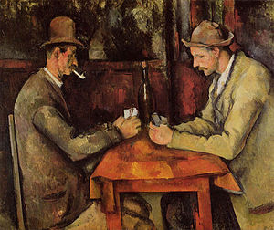

Game-Theoretic Methods in
Machine Learning
Marcello Pelillo
European Centre for Living Technology
Ca’ Foscari University, Venice
2nd Winter School on Data Analytics, Nizhny Novgorod, Russia, October 3-4, 2017

Slide 2
From Cliques to Equilibria Dominant-Set Clustering and Its Applications

Slide 3
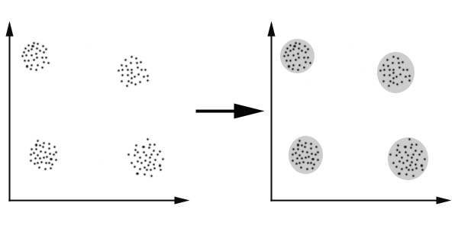
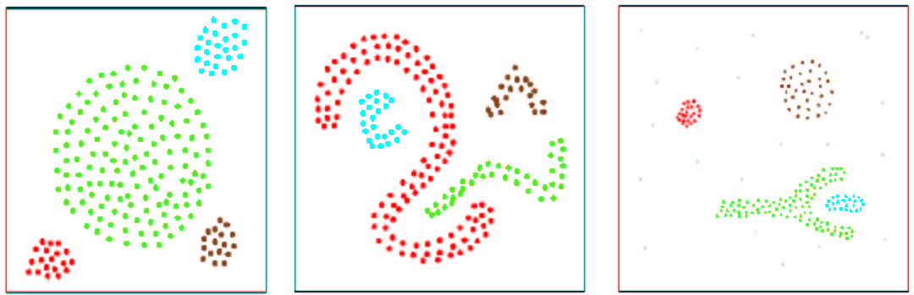
The “Classical” Clustering Problem
Given:
a set of n “objects”
an n × n matrix A of pairwise similarities
Goal: Partition the vertices of the G into maximally homogeneous groups (i.e., clusters).
Usual assumption: symmetric and pairwise similarities (G is an undirected graph)
= an edge-weighted graph G

Slide 4
Applications
Clustering problems abound in many areas of computer science and engineering.
A short list of applications domains:
Image processing and computer vision
Computational biology and bioinformatics
Information retrieval
Document analysis
Medical image analysis
Data mining
Signal processing
…
For a review see, e.g., A. K. Jain, "Data clustering: 50 years beyond K-means,” Pattern Recognition Letters 31(8):651-666, 2010.

Slide 5
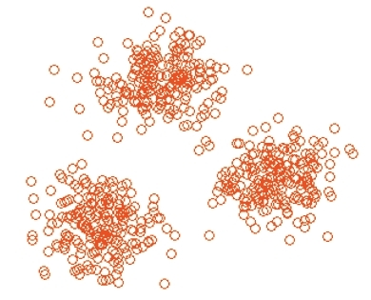
What is a Cluster?
No universally accepted (formal) definition of a “cluster” but, informally, a cluster should satisfy two criteria:
Internal criterion: all “objects” inside a cluster should be highly similar to each other
External criterion: all “objects” outside a cluster should be highly dissimilar to the ones inside

Slide 6
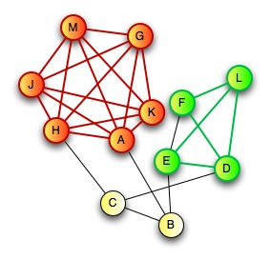
A Special Case:
Binary Symmetric Similarities
Suppose the similarity matrix is a binary (0/1) matrix.
Given an unweighted undirected graph G=(V,E):
A clique is a subset of mutually adjacent vertices
A maximal clique is a clique that is not contained in a larger one
In the 0/1 case, a meaningful (though strict) notion of a cluster is that of a maximal clique (Luce & Perry, 1949).

Slide 7
Advantages of the New Approach
No need to know the number of clusters in advance (since we extract them sequentially)
Leaves clutter elements unassigned (useful, e.g., in figure/ground separation or one-class clustering problems)
Allows extracting overlapping clusters
Works with asymmetric/negative/high-order similarities
Need a partition?
Partition_into_clusters(V,A)
repeat
Extract_a_cluster
remove it from V
until all vertices have been clustered

Slide 8
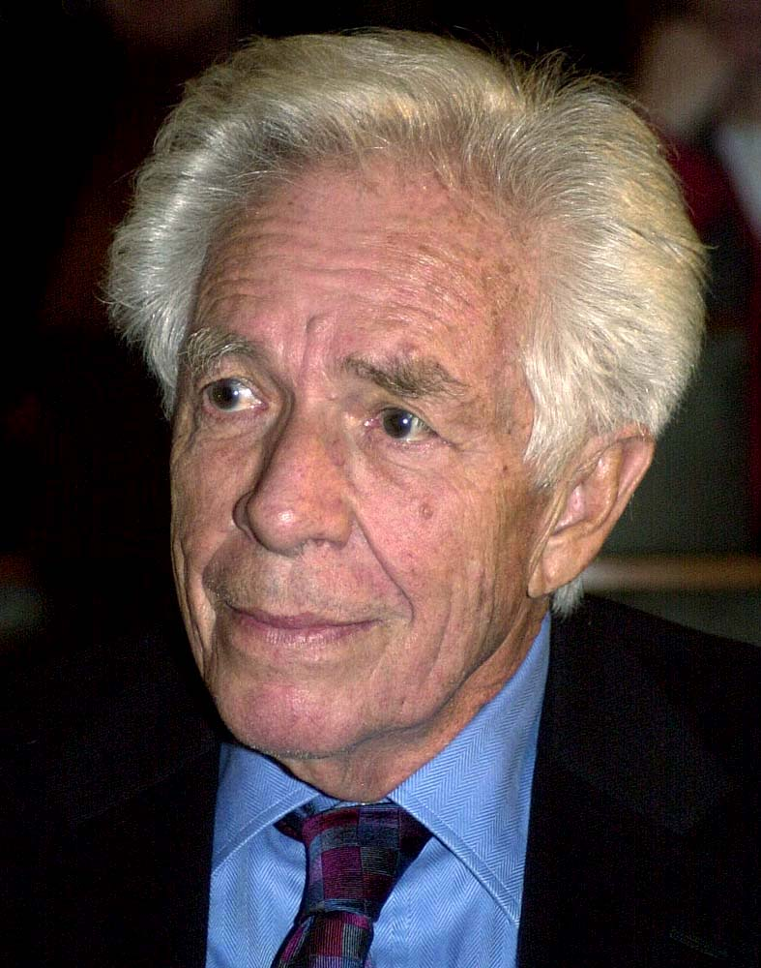
What is Game Theory?
“The central problem of game theory was posed by von Neumann as early as 1926 in Göttingen. It is the following:
If n players, P₁,…, P_{n}, play a given game Γ, how must the i^{th} player, P_{i}, play to achieve the most favorable result for himself?”
Harold W. Kuhn
Lectures on the Theory of Games (1953)
A few cornerstones in game theory
1921−1928: Emile Borel and John von Neumann give the first modern formulation of a mixed strategy along with the idea of finding minimax solutions of normal-form games.
1944, 1947: John von Neumann and Oskar Morgenstern publish Theory of Games and Economic Behavior.
1950−1953: In four papers John Nash made seminal contributions to both non-cooperative game theory and to bargaining theory.
1972−1982: John Maynard Smith applies game theory to biological problems thereby founding “evolutionary game theory.”
late 1990’s −: Development of algorithmic game theory…
Notes:
DECISIONS VERSUS GAMES
Decision - may have several stages and need a sequential plan of action (strategy), but environment is neutral
Game - interaction with others, who are similarly strategically aware purposive players, whose interests may conflict with yours
Need at least two "players" to make a game
Old terminology - decisions called games against "nature"

Slide 9
“Solving” a Game
 |  | Player 2
 |  | Left | Middle | Right
Player 1 | Top | 3 , 1 | 2 , 3 | 10 , 2
 | High | 4 , 5 | 3 , 0 | 6 , 4
 | Low | 2 , 2 | 5 , 4 | 12 , 3
 | Bottom | 5 , 6 | 4 , 5 | 9 , 7
Nash equilibrium!

Slide 10
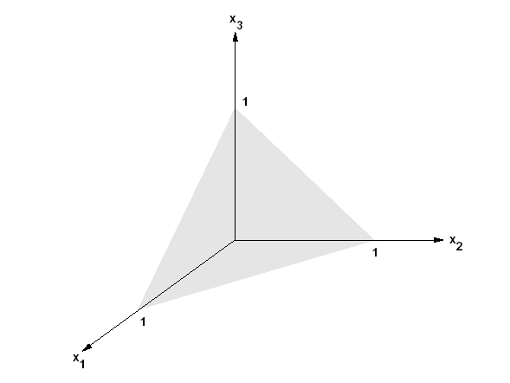
Basics of (Two-Player, Symmetric)
Game Theory
Assume:
a (symmetric) game between two players
complete knowledge
a pre-existing set of pure strategies (actions) O={o₁,…,o_{n}} available to the players.
Each player receives a payoff depending on the strategies selected by him and by the adversary. Players’ goal is to maximize their own returns.
A mixed strategy is a probability distribution x=(x₁,…,x_{n})^{T} over the strategies.

Slide 11
Nash Equilibria
Let A be an arbitrary payoff matrix: a_{ij} is the payoff obtained by playing i while the opponent plays j.
The average payoff obtained by playing mixed strategy y while the opponent plays x, is:
A mixed strategy x is a (symmetric) Nash equilibrium if
for all strategies y. (Best reply to itself.)
Theorem (Nash, 1951). Every finite normal-form game admits a mixed-strategy Nash equilibrium.

Slide 12
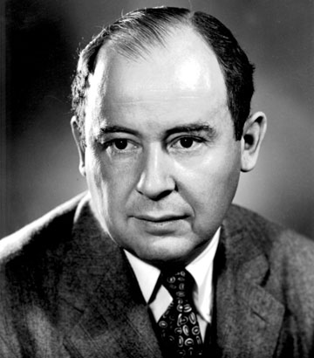
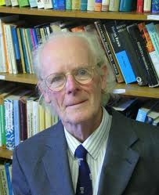
Evolution and the Theory of Games
“We repeat most emphatically that our theory is thoroughly static. A dynamic theory would unquestionably be more complete and therefore preferable.
But there is ample evidence from other branches of science that it is futile to try to build one as long as the static side is not thoroughly understood.”
John von Neumann and Oskar Morgenstern
Theory of Games and Economic Behavior (1944)
“Paradoxically, it has turned out that game theory is more readily applied to biology than to the field of economic behaviour for which it was originally designed.”
John Maynard Smith
Evolution and the Theory of Games (1982)

Slide 13
Evolutionary Games and ESS’s
Assumptions:
A large population of individuals belonging to the same species which compete for a particular limited resource
This kind of conflict is modeled as a symmetric two-player game, the players being pairs of randomly selected population members
Players do not behave “rationally” but act according to a pre-programmed behavioral pattern (pure strategy)
Reproduction is assumed to be asexual
Utility is measured in terms of Darwinian fitness, or reproductive success
A Nash equilibrium x is an Evolutionary Stable Strategy (ESS) if, for all strategies y:

Slide 14
ESS’s as Clusters
We claim that ESS’s abstract well the main characteristics of a cluster:
Internal coherency: High mutual support of all elements within the group.
External incoherency: Low support from elements of the group to elements outside the group.

Slide 15
Basic Definitions
Let S ⊆ V be a non-empty subset of vertices, and i∈S.
The (average) weighted degree of i w.r.t. S is defined as:
Moreover, if j ∉ S, we define:
i
j
S
Intuitively, φ_{S}(i,j) measures the similarity between vertices j and i, with respect to the (average) similarity between vertex i and its neighbors in S.

Slide 16
Assigning Weights to Vertices
Let S ⊆ V be a non-empty subset of vertices, and i∈S.
The weight of i w.r.t. S is defined as:
S - { i }
Further, the total weight of S is defined as:
j
i
S

Slide 17
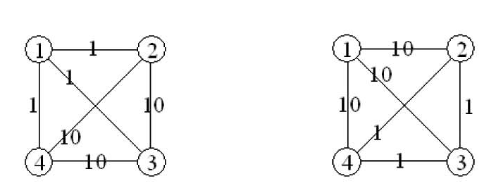
Interpretation
Intuitively, w_{S}(i) gives us a measure of the overall (relative) similarity between vertex i and the vertices of S-{i} with respect to the overall similarity among the vertices in S-{i}.
w_{{1,2,3,4}}(1) < 0
w_{{1,2,3,4}}(1) > 0

Slide 18
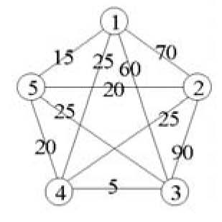
Dominant Sets
Definition (Pavan and Pelillo, 2003, 2007). A non-empty subset of vertices S ⊆ V such that W(T) > 0 for any non-empty T ⊆ S, is said to be a dominant set if:
w_{S}(i) > 0, for all i ∈ S (internal homogeneity)
w_{S∪{i}}(i) < 0, for all i ∉ S (external homogeneity)
Dominant sets ≡ clusters
The set {1,2,3} is dominant.

Slide 19
The Clustering Game
Consider the following “clustering game.”
Assume a preexisting set of objects O and a (possibly asymmetric) matrix of affinities A between the elements of O.
Two players play by simultaneously selecting an element of O.
After both have shown their choice, each player receives a payoff proportional to the affinity that the chosen element has wrt the element chosen by the opponent.
Clearly, it is in each player’s interest to pick an element that is strongly supported by the elements that the adversary is likely to choose.
Hence, in the (pairwise) clustering game:
There are 2 players (because we have pairwise affinities)
The objects to be clustered are the pure strategies
The (null-diagonal) affinity matrix coincides with the similarity matrix

Slide 20
Dominant Sets are ESS’s
Theorem (Torsello, Rota Bulò and Pelillo, 2006). Evolutionary stable strategies of the clustering game with affinity matrix A are in a one-to-one correspondence with dominant sets.
Note. Generalization of well-known Motzkin-Straus theorem from graph theory (1965).
Dominant-set clustering
To get a single dominant-set cluster use, e.g., replicator dynamics (but see Rota Bulò, Pelillo and Bomze, CVIU 2011, for faster dynamics)
To get a partition use a simple peel-off strategy: iteratively find a dominant set and remove it from the graph, until all vertices have been clustered
To get overlapping clusters, enumerate dominant sets (see Bomze, 1992; Torsello, Rota Bulò and Pelillo, 2008)

Slide 21
Special Case:
Symmetric Affinities
Given a symmetric real-valued matrix A (with null diagonal), consider the following Standard Quadratic Programming problem (StQP):
maximize ƒ(x) = x^{T}Ax
subject to x∈∆
Note. The function ƒ(x) provides a measure of cohesiveness of a cluster (see Pavan and Pelillo, 2003, 2007; Sarkar and Boyer, 1998; Perona and Freeman, 1998).
ESS’s are in one-to-one correspondence
to (strict) local solutions of StQP
Note. In the 0/1 (symmetric) case, ESS’s are in one-to-one correspondence to (strictly) maximal cliques (Motzkin-Straus theorem).

Slide 22
Replicator Dynamics
Let x_{i}(t) the population share playing pure strategy i at time t. The state of the population at time t is: x(t)= (x₁(t),…,x_{n}(t))∈∆.
Replicator dynamics (Taylor and Jonker, 1978) are motivated by Darwin’s principle of natural selection:
which yields:
Theorem (Nachbar, 1990; Taylor and Jonker, 1978). A point x∈∆ is a Nash equilibrium if and only if x is the limit point of a replicator dynamics trajectory starting from the interior of ∆.
Furthermore, if x∈∆ is an ESS, then it is an asymptotically stable equilibrium point for the replicator dynamics.

Slide 23
Doubly Symmetric Games
In a doubly symmetric (or partnership) game, the payoff matrix A is symmetric (A = A^{T}).
Fundamental Theorem of Natural Selection (Losert and Akin, 1983).
For any doubly symmetric game, the average population payoff ƒ(x) = x^{T}Ax is strictly increasing along any non-constant trajectory of replicator dynamics, namely, d/dtƒ(x(t)) ≥ 0 for all t ≥ 0, with equality if and only if x(t) is a stationary point.
Characterization of ESS’s (Hofbauer and Sigmund, 1988)
For any doubly simmetric game with payoff matrix A, the following statements are equivalent:
x ∈ ∆^{ESS}
x ∈ ∆ is a strict local maximizer of ƒ(x) = x^{T}Ax over the standard simplex ∆
x ∈ ∆ is asymptotically stable in the replicator dynamics

Slide 24
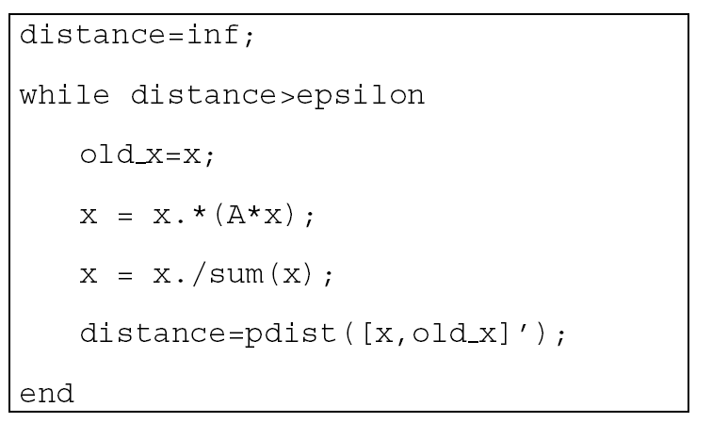
Discrete-time Replicator Dynamics
A well-known discretization of replicator dynamics, which assumes non-overlapping generations, is the following (assuming a non-negative A):
which inherits most of the dynamical properties of its continuous-time counterpart (e.g., the fundamental theorem of natural selection).
MATLAB implementation

Slide 25

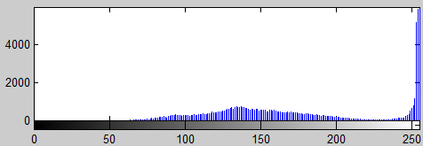
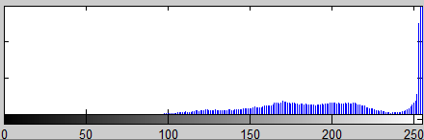
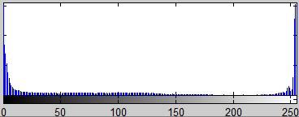

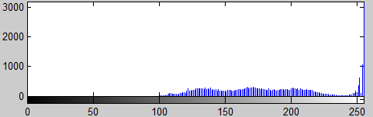
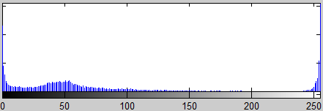
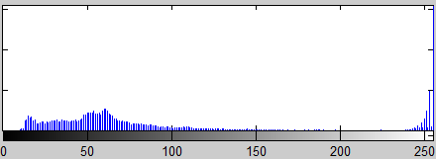
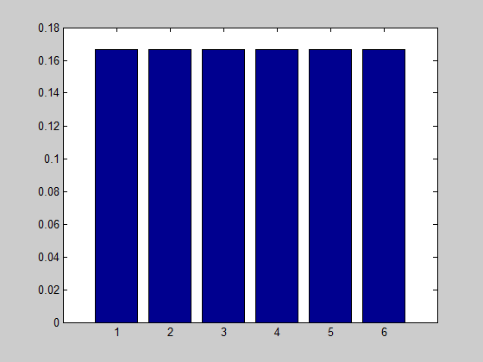






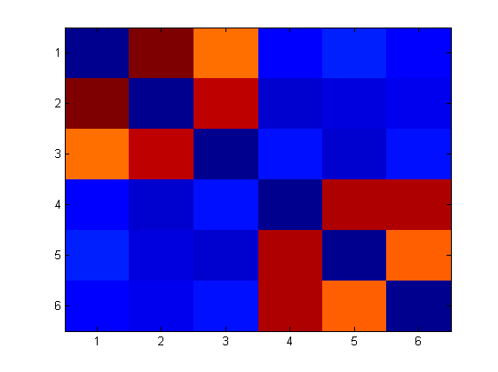





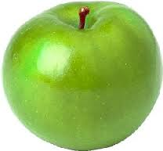

A Toy Example
Notes:
25
In this slide we can see a toy example. Given a set of apples and their RGB histogram we compute an affinity matrix based on the Euclidean distance between each pair. Distances are converted to a similarity through a Gaussian kernel (see picture). On the right side you can see the Replicator Dynamics in action over the similarity matrix. As you can see R.D. are able to select the groups.
25

Slide 26
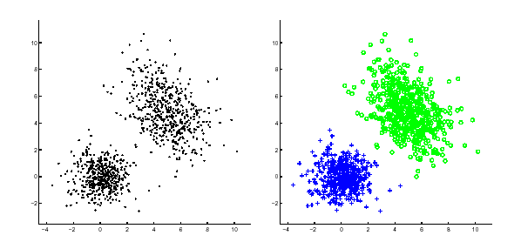
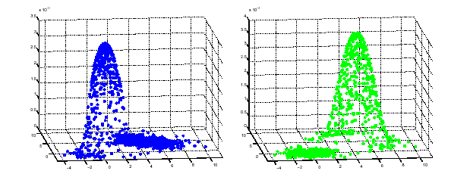
Measuring the Degree of Cluster Membership
The components of the converged vector give us a measure of the participation of the corresponding vertices in the cluster, while the value of the objective function provides of the cohesiveness of the cluster.

Slide 27
Application to Image Segmentation
An image is represented as an edge-weighted undirected graph, where vertices correspond to individual pixels and edge-weights reflect the “similarity” between pairs of vertices.
For the sake of comparison, in the experiments we used the same similarities used in Shi and Malik’s normalized-cut paper (PAMI 2000).
To find a hard partition, the following peel-off strategy was used:
Partition_into_dominant_sets(G)
Repeat
find a dominant set
remove it from graph
until all vertices have been clustered
To find a single dominant set we used replicator dynamics (but see Rota Bulò, Pelillo and Bomze, CVIU 2011, for faster game dynamics).

Slide 28
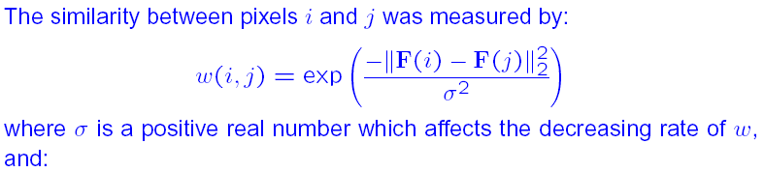
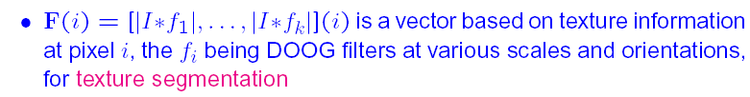
Experimental Setup

Slide 29
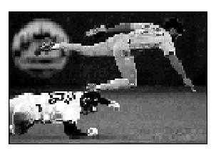
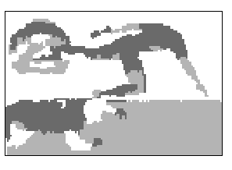
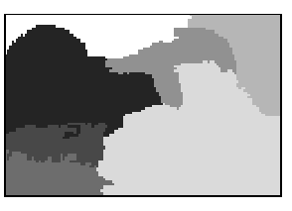
Intensity Segmentation Results
Dominant sets
Ncut

Slide 30
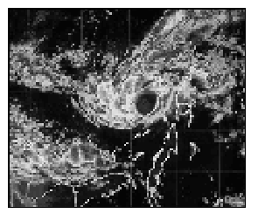
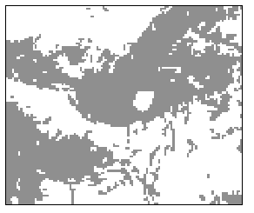
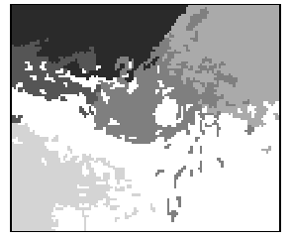
Intensity Segmentation Results
Dominant sets Ncut

Slide 31
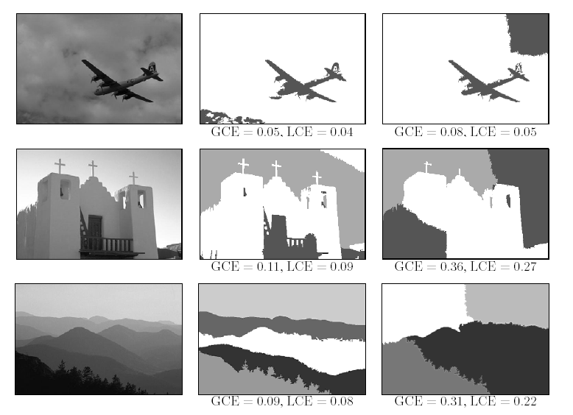
Results on the Berkeley Dataset
Dominant sets Ncut

Slide 32
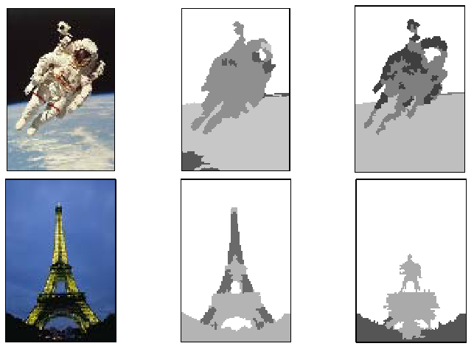
Color Segmentation Results
Original image Dominant sets Ncut

Slide 33
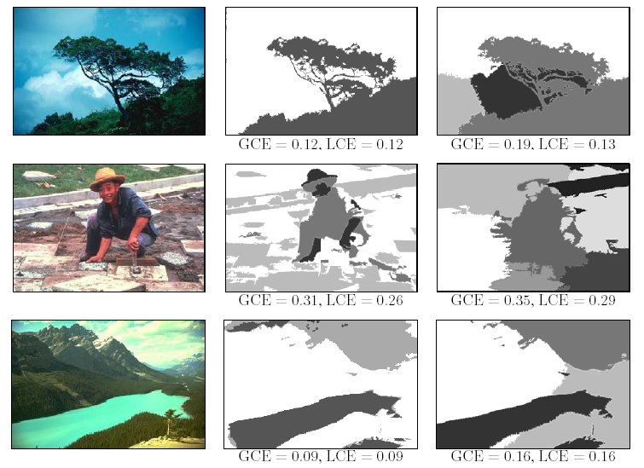
Results on the Berkeley Dataset
Dominant sets Ncut

Slide 34
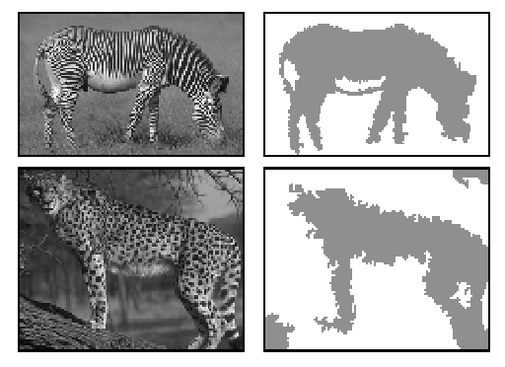
Texture Segmentation Results
Dominant sets

Slide 35
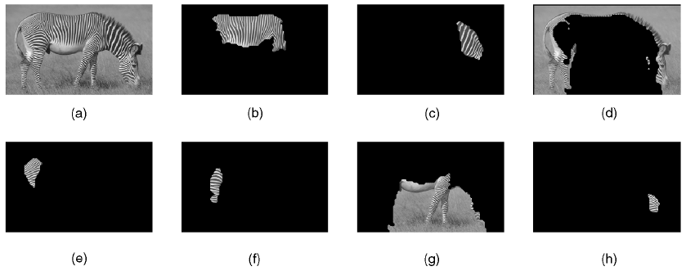
Texture Segmentation Results
NCut

Slide 36
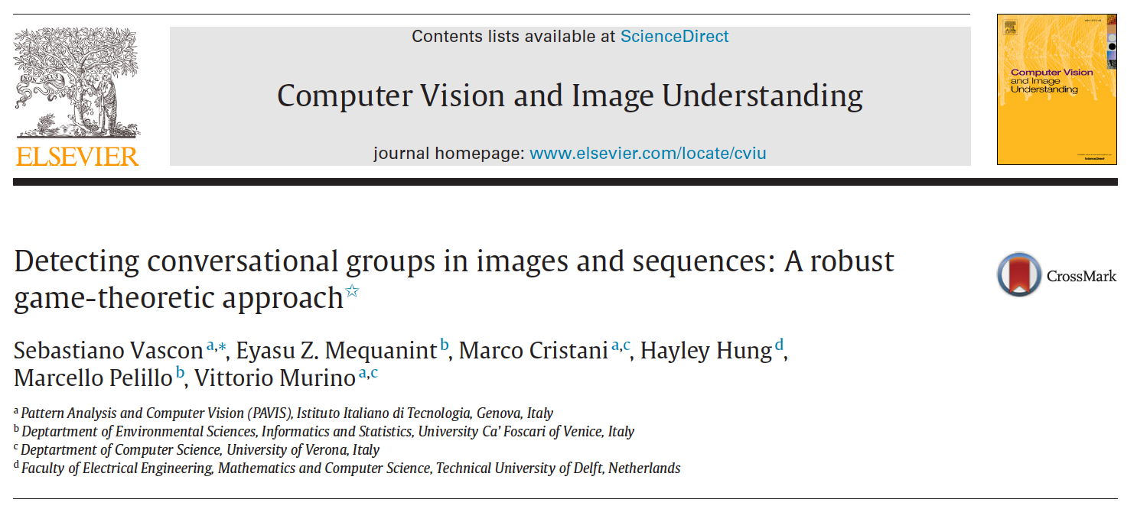

Slide 37
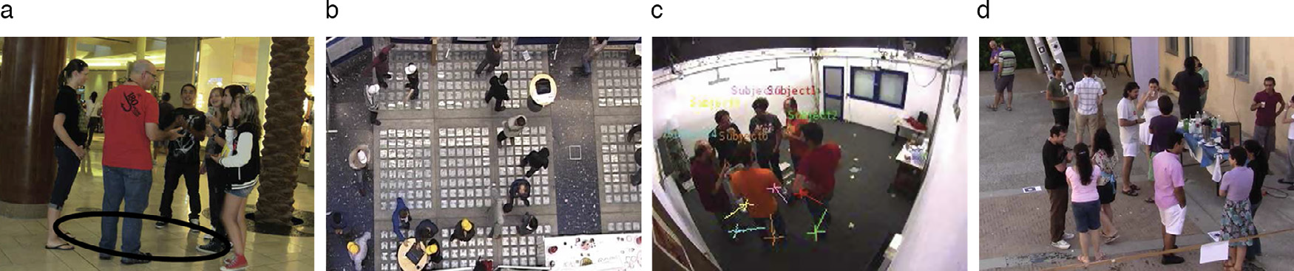
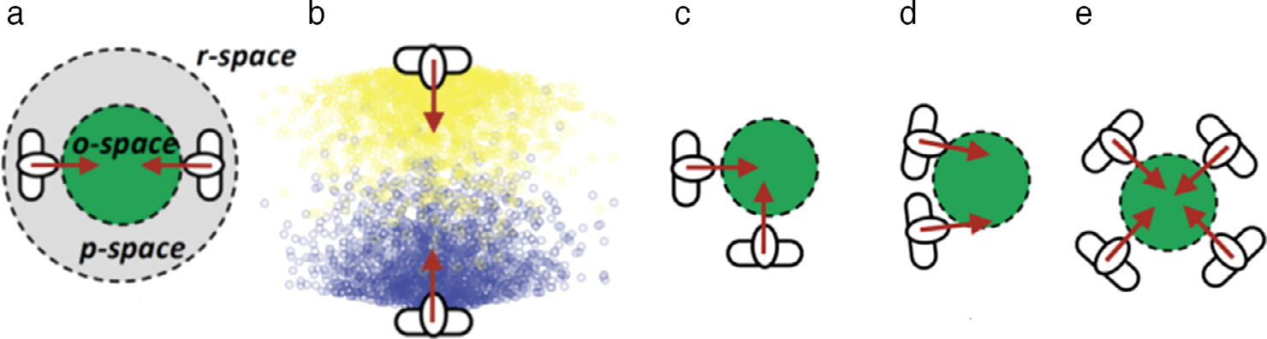
F-formations
“Whenever two or more individuals in close proximity orient their bodies in such a way that each of them has an easy, direct and equal access to every other participant’s transactional segment”
Ciolek & Kendon (1980)

Slide 38
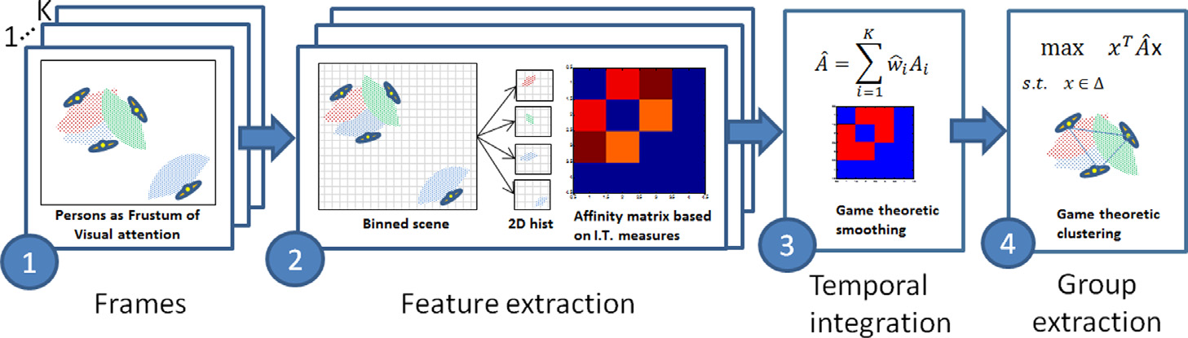
System Architecture
Frustrum of visual attention
A person in a scene is described by his/her position (x,y) and the head orientation θ
The frustum represents the area in which a person can sustain a conversation and is defined by an aperture and by a length

Slide 39
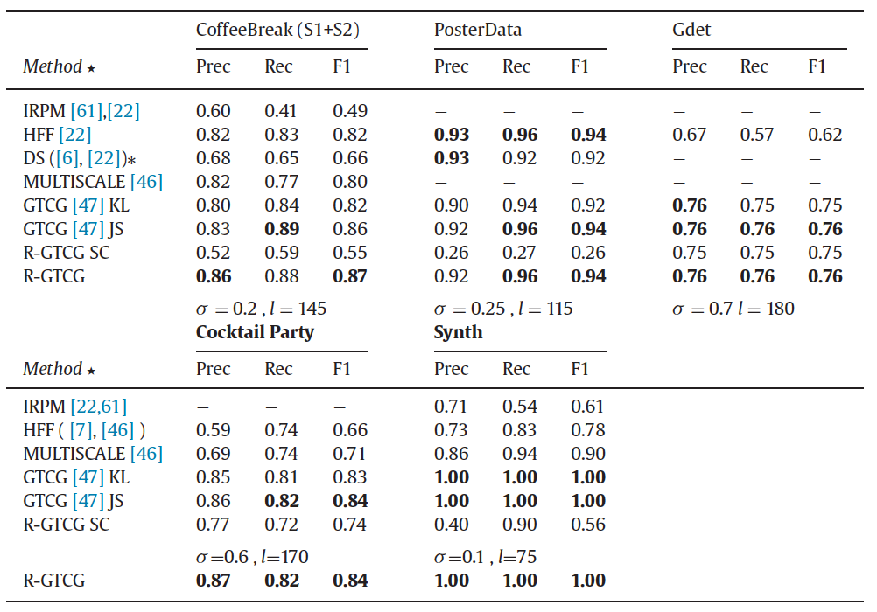
Results
Spectral
Clustering

Slide 40
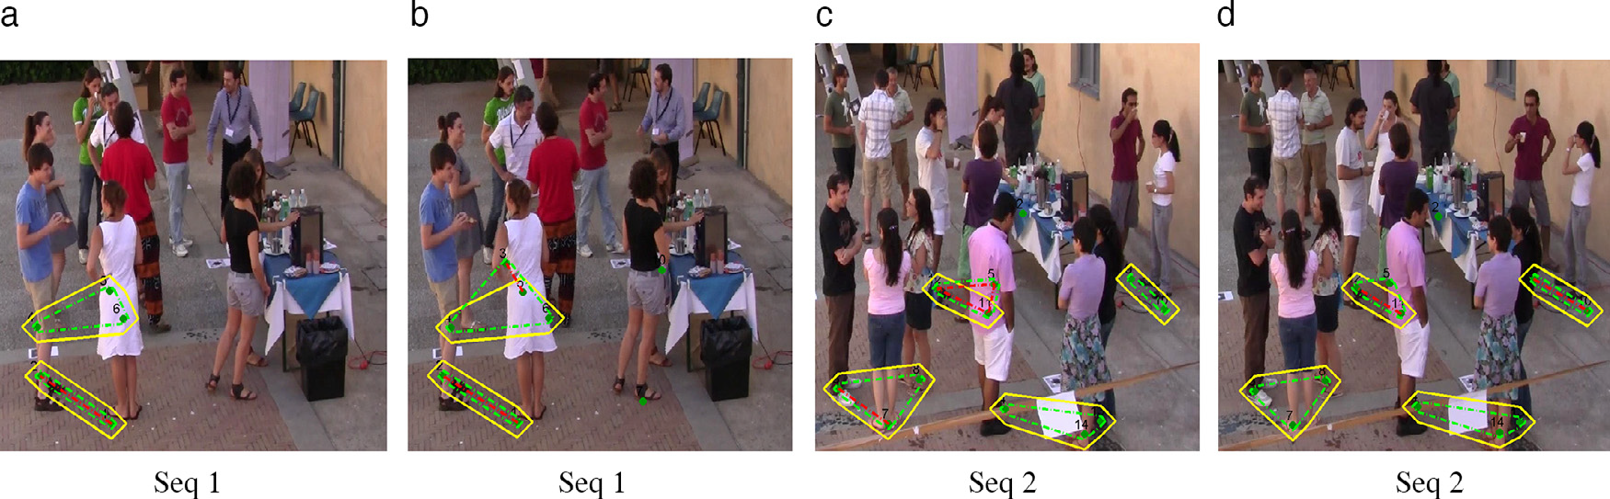
Results
Qualitative results on the CoffeeBreak dataset compared with the state of the art HFF.
Yellow = ground truth
Green = our method
Red = HFF.

Slide 41
Other Applications of Dominant-Set Clustering
Bioinformatics
Identification of protein binding sites (Zauhar and Bruist, 2005)
Clustering gene expression profiles (Li et al, 2005)
Tag Single Nucleotide Polymorphism (SNPs) selection (Frommlet, 2010)
Security and video surveillance
Detection of anomalous activities in video streams (Hamid et al., CVPR’05; AI’09)
Detection of malicious activities in the internet (Pouget et al., J. Inf. Ass. Sec. 2006)
Detection of F-formations (Hung and Kröse, 2011)
Content-based image retrieval
Wang et al. (Sig. Proc. 2008); Giacinto and Roli (2007)
Analysis of fMRI data
Neumann et al (NeuroImage 2006); Muller et al (J. Mag Res Imag. 2007)
Video analysis, object tracking, human action recognition
Torsello et al. (EMMCVPR’05); Gualdi et al. (IWVS’08); Wei et al. (ICIP’07)
Feature selection
Hancock et al. (GbR’11; ICIAP’11; SIMBAD’11)
Image matching and registration
Torsello et al. (IJCV 2011, ICCV’09, CVPR’10, ECCV’10)

Slide 42
Extensions

Slide 43
Finding Overlapping Classes
First idea: run replicator dynamics from different starting points in the simplex.
Problem: computationally expensive and no guarantee to find them all.

Slide 44
Finding Overlapping Classes: Intuition

Slide 45
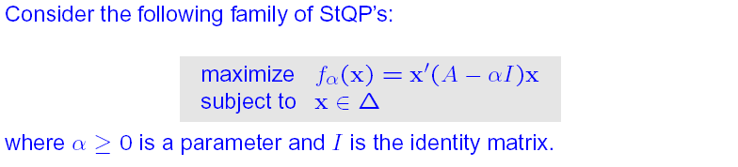
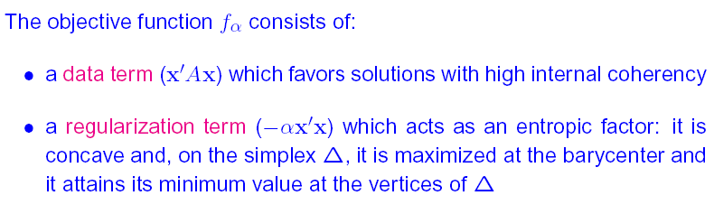
Building a Hierarchy: A Family of Quadratic Programs

Slide 46
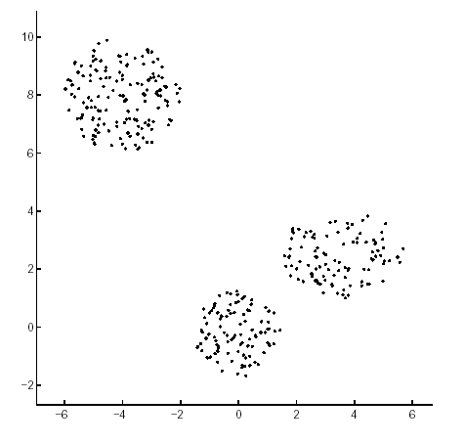
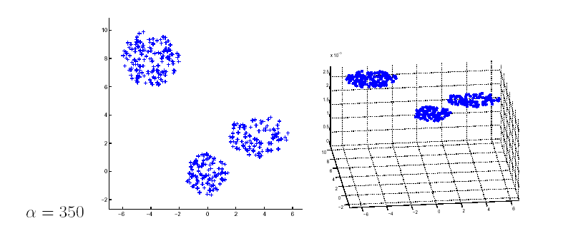
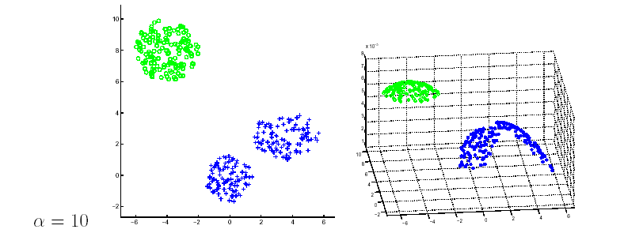
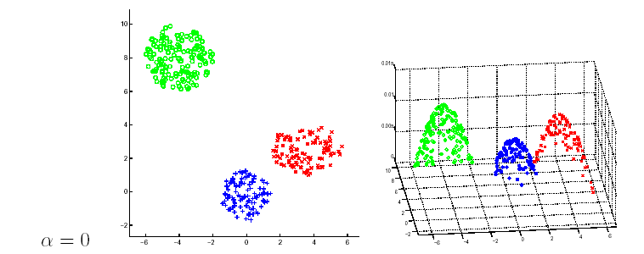
The effects of α

Slide 47
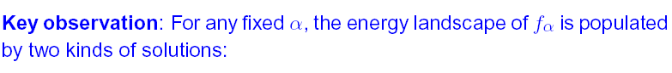
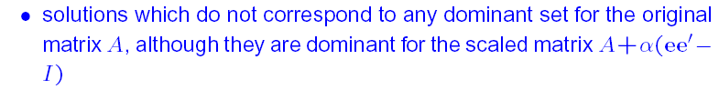

The Landscape of f_{α}

Slide 48

Sketch of the Hierarchical Clustering Algorithm

Slide 49

Dealing with High-Order Similarities
A (weighted) hypergraph is a triplet H = (V, E, w), where
V is a finite set of vertices
E ⊆ 2^{V} is the set of (hyper-)edges (where 2^{V} is the power set of V)
w : E → R is a real-valued function assigning a weight to each edge
We will focus on a particular class of hypergraphs, called k-graphs, whose edges have fixed cardinality k ≥ 2.
A hypergraph where the vertices are flag colors and the hyperedges are flags.

Slide 50
The Hypergraph Clustering Game
Given a weighted k-graph representing an instance of a hypergraph clustering problem, we cast it into a k-player (hypergraph) clustering game where:
There are k players
The objects to be clustered are the pure strategies
The payoff function is proportional to the similarity of the objects/strategies selected by the players
Definition (ESS-cluster). Given an instance of a hypergraph clustering problem H = (V,E,w), an ESS-cluster of H is an ESS of the corresponding hypergraph clustering game.
Like the k=2 case, ESS-clusters do incorporate both internal and external cluster criteria (see PAMI 2013)

Slide 51

ESS’s and Polynomial Optimization

Slide 52


Baum-Eagon Inequality

Slide 53

An exampe: Line Clustering
Notes:
We randomly generated a few lines (in our experiments, from 2 to 4) in the 5D hypercube and then added from 0 to 40 clutter points uniformly drawn from the hypercube
In order to make the setting more realistic, we also slightly perturbed the original lines using a local Gaussian noise with standard deviation
0.01.
As in the previous set of experiments, each generated line consisted of 20 points.

Slide 54
In a nutshell…
The game-theoretic/dominant-set approach:
makes no assumption on the structure of the affinity matrix, being it able to work with asymmetric and even negative similarity functions
does not require a priori knowledge on the number of clusters (since it extracts them sequentially)
leaves clutter elements unassigned (useful, e.g., in figure/ground separation or one-class clustering problems)
allows principled ways of assigning out-of-sample items (NIPS’04)
allows extracting overlapping clusters (ICPR’08)
generalizes naturally to hypergraph clustering problems, i.e., in the presence of high-order affinities, in which case the clustering game is played by more than two players (PAMI’13)
extends to hierarchical clustering (ICCV’03: EMMCVPR’09)
allows using multiple affinity matrices using Pareto-Nash notion (SIMBAD’15)

Slide 55
References
S. Rota Bulò and M. Pelillo. Dominant-set clustering: A review. Europ. J. Oper. Res. (2017)
M. Pavan and M. Pelillo. Dominant sets and pairwise clustering. PAMI 2007.
M. Pavan and M. Pelillo. Dominant sets and hierarchical clustering. ICCV 2003.
M. Pavan and M. Pelillo. Efficient out-of-sample extension of dominant-set clusters. NIPS 2004.
A. Torsello, S. Rota Bulò and M. Pelillo. Grouping with asymmetric affinities: A game-theoretic perspective. CVPR 2006.
A. Torsello, S. Rota Bulò and M. Pelillo. Beyond partitions: Allowing overlapping groups in pairwise clustering. ICPR 2008.
S. Rota Bulò and M. Pelillo. A game-theoretic approach to hypergraph clustering. PAMI’13.
S. Rota Bulò, M. Pelillo and I. M. Bomze. Graph-based quadratic optimization: A fast evolutionary approach. CVIU 2011.

Slide 56

Hume-Nash Machines Context-Aware Models of Learning and Recognition

Slide 57


Machine learning:
The standard paradigm
From: Duda, Hart and Stork, Pattern Classification (2000)

Slide 58
Limitations
There are cases where it’s not easy to find satisfactory feature-vector representations.
Some examples
when experts cannot define features in a straightforward way
when data are high dimensional
when features consist of both numerical and categorical variables,
in the presence of missing or inhomogeneous data
when objects are described in terms of structural properties
…

Slide 59
Tacit assumptions
Objects possess “intrinsic” (or essential) properties
Objects live in a vacuum
In both cases:
Relations are neglected!

Slide 60
The many types of relations
Similarity relations between objects
Similarity relations between categories
Contextual relations
…
Application domains: Natural language processing, computer vision, computational biology, adversarial contexts, social signal processing, medical image analysis, social network analysis, network medicine, …

Slide 61

Context helps …

Slide 62




… but can also deceive!

Slide 63



Context and the brain
From: M. Bar, “Visual objects in context”, Nature Reviews Neuroscience, August 2004.

Slide 64
Beyond features?
The field is showing an increasing propensity towards relational approaches, e.g.,
Kernel methods
Pairwise clustering (e.g., spectral methods, game-theoretic methods)
Graph transduction
Dissimilarity representations (Duin et al.)
Theory of similarity functions (Blum, Balcan, …)
Relational / collective classification
Graph mining
Contextual object recognition
…
See also “link analysis” and the parallel development of “network science” …

Slide 65















The SIMBAD project
University of Venice (IT)‏, coordinator
University of York (UK)‏
Technische Universität Delft (NL)‏
Insituto Superior Técnico, Lisbon (PL)‏
University of Verona (IT)‏
ETH Zürich (CH)‏
http://simbad-fp7.eu

Slide 66


The SIMBAD book
M. Pelillo (Ed.)
Similarity-Based Pattern Analysis and Recognition (2013)

Slide 67
Challenges to similarity-based approaches
Departing from vector-space representations:
dealing with (dis)similarities that might not possess the Euclidean behavior or not even obey the requirements of a metric
lack of Euclidean and/or metric properties undermines the foundations of traditional pattern recognition algorithms
The customary approach to deal with non-(geo)metric (dis)similarities is embedding.
based on the assumption that the non-geometricity of similarity information can be eliminated or somehow approximated away
when there is significant information content in the non-geometricity of the data, alternative approaches are needed

Slide 68



The need for non-metric similarities
«Any computer vision system that attempts to faithfully reflect human judgments of similarity is apt to devise non-metric image distance functions.»
Jacobs, Weinshall and Gdalyahu, 2000
w₁
w₂
w₃
w₃ > w₁ + w₂
Adapted from: D. W. Jacobs, D. Weinshall, and Y. Gdalyahu. Classication with non-metric distances: Image retrieval and class representation. PAMI 2000.

Slide 69

The symmetry assumption
«Similarity has been viewed by both philosophers and psychologists as a prime example of a symmetric relation. Indeed, the assumption of symmetry underlies essentially all theoretical treatments of similarity.
Contrary to this tradition, the present paper provides empirical evidence for asymmetric similarities and argues that similarity should not be treated as a symmetric relation.»
Amos Tversky
Features of Similarities (1977)
Examples of asymmetric (dis)similarities:
Kullback-Leibler divergence
Directed Hausdorff distance
Tversky’s contrast model

Slide 70

Hume-Nash machines
A context-aware classification model based on:
The use of similarity principles which go back to the work of British philosopher David Hume
Game-theoretic equilibrium concepts introduced by Nobel laureate John Nash

Slide 71


Hume’s similarity principle
«I have found that such an object has always been attended with such an effect, and I foresee, that other objects, which are, in appearance, similar, will be attended with similar effects.»
David Hume
An Enquiry Concerning Human Understanding (1748)
Compare with standard smoothness assumption:
“points close to each other are more likely to share the same label”

Slide 72
Why game theory?
Answer #1:
Because it works! (well, great…)
Answer #2:
Because it allows us to naturally deal with context-aware problems, non-Euclidean, non-metric, high-order, and whatever-you-like (dis)similarities
Answer #3:
Because it allows us to model in a principled way problems not formulable in terms of simgle-objective optimization principles

Slide 73
The (Consistent) labeling problem
A labeling problem involves:
A set of n objects B = {b₁,…,b_{n}}
A set of m labels Λ = {1,…,m}
The goal is to label each object of B with a label of Λ.
To this end, two sources of information are exploited:
Local measurements which capture the salient features of each object viewed in isolation
Contextual information, expressed in terms of a real-valued n² x m² matrix of compatibility coefficients R = {r_{ij}(λ,μ)}.
The coefficient r_{ij}(λ,μ) measures the strenght of compatibility between the two hypotheses: “b_{i} is labeled λ” and “b_{j} is labeled μ“.

Slide 74
Relaxation labeling processes
In a now classic 1976 paper, Rosenfeld, Hummel, and Zucker introduced the following update rule (assuming a non-negative compatibility matrix):
where
quantifies the support that context gives at time t to the hypothesis “b_{i} is labeled with label λ”.
See (Pelillo, 1997) for a rigorous derivation of this rule in the context of a formal theory of consistency.

Slide 75
Applications
Since their introduction in the mid-1970’s relaxation labeling algorithms have found applications in virtually all problems in computer vision and pattern recognition:
Edge and curve detection and enhancement
Region-based segmentation
Stereo matching
Shape and object recognition
Grouping and perceptual organization
Graph matching
Handwriting interpretation
…
Further, intriguing similarities exist between relaxation labeling processes and certain mechanisms in the early stages of biological visual systems (see Zucker, Dobbins and Iverson, 1989)

Slide 76

Hummel and Zucker’s consistency
In 1983, Hummel and Zucker developed an elegant theory of consistency in labeling problem.
By analogy with the unambiguous case, which is easily understood, they define a weighted labeling assignment p consistent if:
for all labeling assignments v.
If strict inequalities hold for all v ≠ p, then p is said to be strictly consistent.
Geometrical interpretation.
The support vector q points away from all tangent vectors at p (it has null projection in IK).

Slide 77
Relaxation labeling as
non-cooperative Games
As observed by Miller and Zucker (1991) the consistent labeling problem is equivalent to a non-cooperative game.
Indeed, in such formulation we have:
Objects = players
Labels = pure strategies
Weighted labeling assignments = mixed strategies
Compatibility coefficients = payoffs
and:
Consistent labeling = Nash equilibrium
Further, the Rosenfeld-Hummel-Zucker update rule corresponds to discrete-time multi-population replicator dynamics.

Slide 78


Application to semi-supervised learning
Adapted from: O. Duchene, J.-Y. Audibert, R. Keriven, J. Ponce, and F. Ségonne. Segmentation by transduction. CVPR 2008.

Slide 79
Graph transduction
Given a set of data points grouped into:
labeled data:
unlabeled data:
Express data as a graph G=(V,E)
V : nodes representing labeled and unlabeled points
E : pairwise edges between nodes weighted by the similarity between the corresponding pairs of points
Goal: Propagate the information available at the labeled nodes to unlabeled ones in a “consistent” way.
Cluster assumption:
The data form distinct clusters
Two points in the same cluster are expected to be in the same class

Slide 80


A special case
A simple case of graph transduction in which the graph G is an unweighted undirected graph:
An edge denotes perfect similarity between points
The adjacency matrix of G is a 0/1 matrix
The cluster assumption: Each node in a connected component of the graph should have the same class label. A constraint satisfaction problem!

Slide 81
The graph transduction game
Given a weighted graph G = (V, E, w), the graph trasduction game is as follow:
Nodes = players
Labels = pure strategies
Weighted labeling assignments = mixed strategies
Compatibility coefficients = payoffs
The transduction game is in fact played among the unlabeled players to choose their memberships.
Consistent labeling = Nash equilibrium
Can be solved used standard relaxation labeling / replicator dynamics.
Applications: NLP (see next part), interactive image segmentation, content-based image retrieval, people tracking and re-identification, etc.

Slide 82
In short…
Graph transduction can be formulated as a non-cooperative game (i.e., a consistent labeling problem).
The proposed game-theoretic framework can cope with symmetric, negative and asymmetric similarities (none of the existing techniques is able to deal with all three types of similarities).
Experimental results on standard datasets show that our approach is not only more general but also competitive with standard approaches.
A. Erdem and M. Pelillo. Graph transduction as a noncooperative game. Neural Computation 24(3) (March 2012).

Slide 83
Extensions
The approach described here is being naturally extended along several directions:
Using more powerful algorithms than “plain” replicator dynamics (e.g., Porter et al., 2008; Rota Bulò and Bomze, 2010)
Dealing with high-order interactions (i.e., hypergraphs) (e.g., Agarwal et al., 2006; Rota Bulò and Pelillo, 2013)
From the “homophily” to the “Hume” similarity principle
-> “similar objects should be assigned similar labels”
Introducing uncertainty in “labeled” players

Slide 84

Word sense disambiguation
WSD is the task to identify the intended meaning of a word based on the context in which it appears.
One of the stars in the star cluster Pleiades [...]
One of the stars in the last David Lynch film [...]
Cinema
It has been studied since the beginning of NLP and also today is a central topic of this discipline.
Used in applications like text understanding, machine translation, opinion mining, sentiment analysis and information extraction.

Slide 85



Approaches
Supervised approaches
Use sense labeled corpora to build classifiers.
Semi-supervised approaches
Use transductive methods to transfer the information from few labeled words to unlabeled.
Unsupervised approaches
Use a knowledge base to collect all the senses of a given word.
Exploit contextual information to choose the best sense for each word.

Slide 86
WSD games
The WSD problem can be formulated in game-theoretic terms modeling:
the players of the games as the words to be disambiguated.
the strategies of the games as the senses of each word.
the payoff matrices of each game as a sense similarity function.
the interactions among the players as a weighted graph.
Nash equilibria correspond to consistent word-sense assignments!
Word-level similarities: proportional to strength of co-occurrence between words
Sense-level similarities: computed using WordNet / BabelNet ontologies
R. Tripodi and M. Pelillo. A game-theoretic approach to word sense disambiguation. Computational Linguistics 43(1) (January 2017).

Slide 87

An example
There is a financial institution near the river bank.

Slide 88

WSD game dynamics (time = 1)
There is a financial institution near the river bank.

Slide 89

WSD games dynamics (time = 2)
There is a financial institution near the river bank.

Slide 90

WSD game dynamics (time = 3)
There is a financial institution near the river bank.

Slide 91

WSD games dynamics (time = 12)
There is a financial institution near the river bank.

Slide 92


Experimental setup

Slide 93

Experimental results

Slide 94

Experimental results (entity linking)

Slide 95
To sum up
Game theory offers a principled and viable solution to context-aware pattern recognition problems, based on the idea of dynamical competition among hypotheses driven by payoff functions.
Distiguishing features:
No restriction imposed on similarity/payoff function (unlike, e.g., spectral methods)
Shifts the emphasis from optima of objective functions to equilibria of dynamical systems.
On-going work:
Learning payoff functions from data (Pelillo and Refice, 1994)
Combining Hume-Nash machines with deep neural networks
Applying them to computer vision problems such as scene parsing, object recognition, video analysis

Slide 96
References
A. Rosenfeld, R. A. Hummel, and S. W. Zucker. Scene labeling by relaxation operations. IEEE Trans. Syst. Man. Cybern (1976)
R. A. Hummel and S. W. Zucker. On the foundations of relaxation labeling processes. IEEE Trans. Pattern Anal. Machine Intell. (1983)
M. Pelillo. The dynamics of nonlinear relaxation labeling processes. J. Math. Imaging and Vision (1997)
D. A. Miller and S. W. Zucker. Copositive-plus Lemke algorithm solves polymatrix games. Operation Research Letters (1991)
A. Erdem and M. Pelillo. Graph transduction as a non-cooperative game. Neural Computation (2012)
R. Tripodi and M. Pelillo. A game-theoretic approach to word-sense disambiguation. Computational Linguistics (2017)
M. Pelillo and M. Refice. Learning compatibility coefficients for relaxation labeling processes. IEEE Trans. Pattern Anal. Machine Intell. (1994)
S. Rota Bulò and M. Pelillo. Dominant-set clustering: A review. Europ. J. Oper. Res. (2017)

Slide 97


Capturing Elongated Structures / 1

Slide 98





Capturing Elongated Structures / 2

Slide 99

Path-Based Distances (PDB’s)
B. Fischer and J. M. Buhmann. Path-based clustering for grouping of smooth curves and texture segmentation. IEEE Trans. Pattern Anal. Mach. Intell., 25(4):513–518, 2003.

Slide 100


Example: Without PBD (σ = 2)

Slide 101

Example: Without PDB (σ = 4)

Slide 102

Example: Without PDB (σ = 8)

Slide 103

Example: With PDB (σ = 0.5)

Slide 104



Slide 105



Slide 106



Constrained Dominant Sets
Let A denote the (weighted) adjacency matrix of a graph G=(V,E). Given a subset of vertices S ⊆ V and a parameter α > 0, define the following parameterized family of quadratic programs:
where I_{S} is the diagonal matrix whose diagonal elements are set to 1 in correspondence to the vertices contained in V \ S, and to zero otherwise:
Property. By setting:
all local solutions will have a support containing elements of S.

Slide 107

Application to Interactive Image Segmentation
Given an image and some information provided by a user, in the form of a scribble or of a bounding box, to provide as output a foreground object that best reflects the user’s intent.
Left: An input image with different user annotations. Tight bounding box (Tight BB), loose bounding box (Loose BB), a scribble made (only) on the foreground object (Scribbles on FG), scribbles with errors.
Right: Results of the proposed algorithm.

Slide 108

System Overview
Left: Over-segmented image with a user scribble (blue label).
Middle: The corresponding affinity matrix, using each over-segments as a node, showing its two parts: S, the constraint set which contains the user labels, and V n S, the part of the graph which takes the regularization parameter .
Right: RRp, starts from the barycenter and extracts the first dominant set and update x and M, for the next extraction till all the dominant sets which contain the user labeled regions are extracted.

Slide 109

Results

Slide 110

Results
Bounding box Result Scribble Result Ground truth

Slide 111

Results
Bounding box Result Scribble Result Ground truth

Slide 112
The “protein function predition” game
Motivation: network-based methods for the automatic prediction of protein functions can greatly benefit from exploiting both the similarity between proteins and the similarity between functional classes.
Hume’s principle: similar proteins should have similar functionalities
We envisage a (non-cooperative) game where
Players = proteins,
Strategies = functional classes
Payoff function = combination of protein- and function-level similarities
Nash equilibria turn out to provide consistent functional labelings of proteins.

Slide 113

Protein similarity
The similarity between proteins has been calculated integrating different data types.
The final similarity matrix for each organism is obtained integrating the 8 sources via an unweighted mean.

Slide 114

Funtion similarity
The similarities between the classes functionalities have been computed using the Gene Ontology (GO)
The similarity between the GO terms for each integrated network and each ontology are computed using:
semantic similarities measures (Resnick or Lin)
a Jaccard similarity measure between the annotations of each GO term.

Slide 115

Preliminary results
Networks: DanXen (includes zebrafish and frog proteins), Dros (fruit fly), SacPomDic (includes the proteins of three unicellular eukaryotes).
CC = cellular component / BP = biological processs
Number of nodes (proteins): from 3195 (Dros) to 15836 (SacPomDic)
CC terms (classes): from 184 to 919
BP terms (classes): from 2281 to 5037
Competitors
Random Walk (RW)
Random Walk with Restart (RWR)
Funckenstein (GBA)
Multi Source-kNN method (MS-kNN)
RANKS

